Slide 1
Visualizing SMA Crossovers
Research and Analysis, Model, and Discussion
Traders@SMU – April 30, 2025

Slide 2
Agenda
Visualizing SMA Crossovers
Moving Averages Overview
SMA overview
Trend Direction and Price Action
SMA Crossover Model (n= 50, 200)
SMA Crossover Results NVDA
EMA overview
EMA Crossover Model
EMA Crossover Results TSLA
When to use: SMA vs. EMA
Limitations of SMA and EMA
Conclusions
References

Slide 3
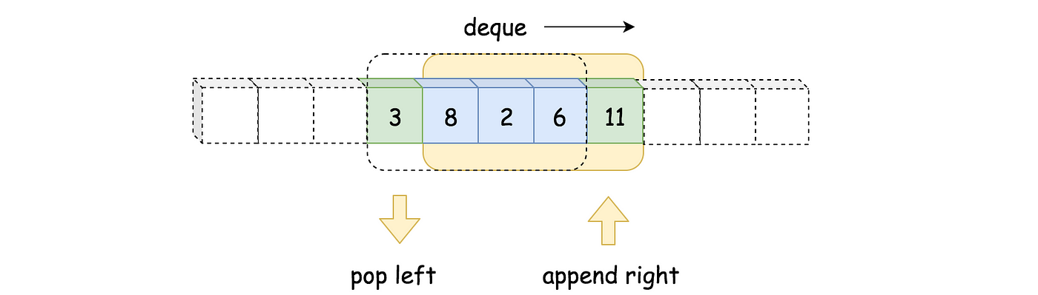
What is a Moving Average?
Visualizing SMA Crossovers
Definition
A moving average is a statistical method used to analyze data points by creating a series of averages from different subsets of a complete data set. It smooths out short-term fluctuations and highlights longer-term trends or cycles.
Visual Example of Moving Average

Slide 4
Why use Moving Averages in Trading?
Visualizing SMA Crossovers
Uses
Equation
Use for different window sizes
Types of Moving Averages Most Used in Trading
1
Trend Identification: They help smooth out price data to reveal the underlying direction.
Signal Generation:
Crossovers (e.g., short-term MA crossing above a long-term MA) can indicate buy or sell signals.
Support and Resistance: Moving averages often act as dynamic support or resistance levels where price may bounce or stall.
Noise Reduction: By averaging out fluctuations, MAs help traders focus on the big picture rather than reacting to every price movement.
Simple Moving Average
2
3
Exponential Moving Average
4

Slide 5
How can we use moving average crossovers as a technical indicator in backtesting?

Slide 6
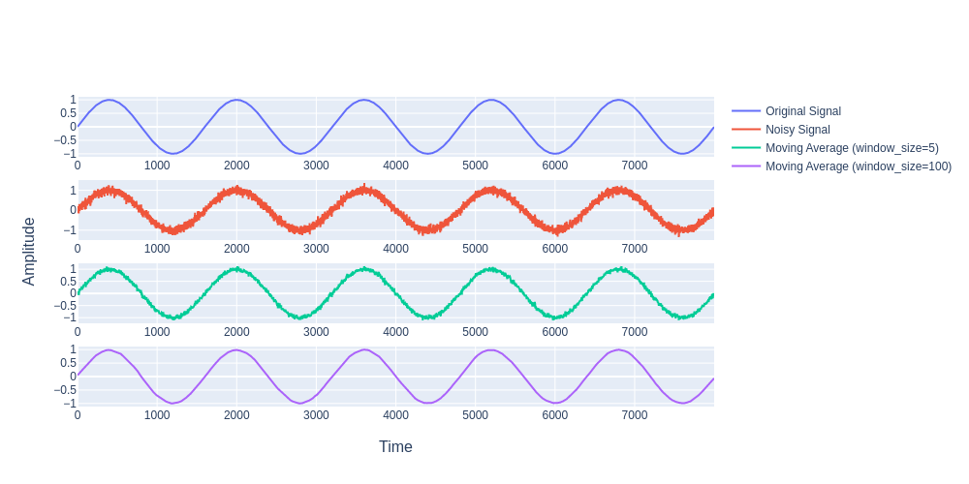
How Moving Average Smoothens Out Noise
Visualizing SMA Crossovers

Slide 7
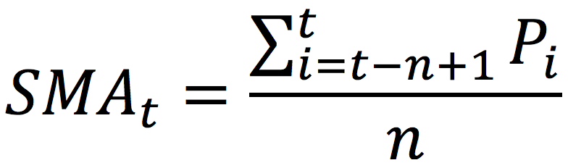
SMA – Simple Moving Average
Visualizing SMA Crossovers
Equation
Equation
Use for different window sizes
Use for Different Window Sizes
50– Day SMA
Key benchmark for stock and index charts
Helps investors avoid reacting to short-term dips in up trending stocks
Often paired with short-term EMA to confirm pricing positions
200 – Day SMA
Key long-term trend indicator and support level
Widely used across markets and strategies for bullish trends
Often used by swing traders to time entry/exit positions
We will be analyzing the crossover of the 50 and 200 Day SMAs.
Components
SMA_{i} = the average of the last n data points ending at time t
n = window size
P_{i} = price at time i
t = total observed values
Σ^{t}_{i=t-n+1} = summation of the prices over the window size (starts at earliest of n points and goes to t, the most recent)

Slide 8
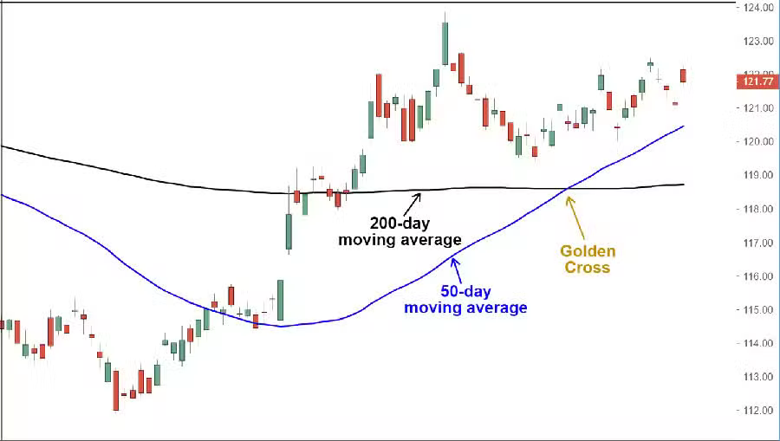
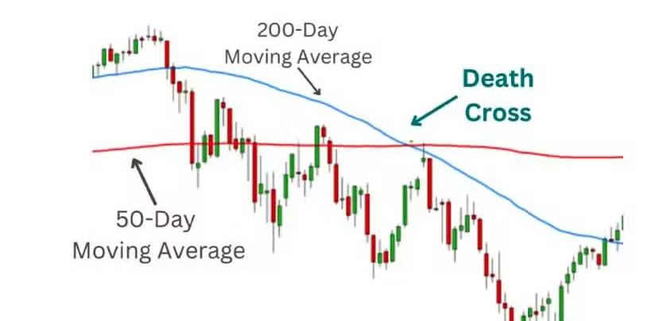
Trend Direction and Price Action
Visualizing SMA Crossovers
The crossovers between the 50- day SMA and the 200- Day SMA can signal major trend reversal
Bullish Signal (Golden Cross)
Happens when the 50-day SMA crosses above the 200-day SMA
Suggests that short-term momentum is picking up
Often seen as the start of a long-term uptrend
Traders may enter long positions
Bearish Signal (Death Cross)
Happens when the 50-day SMA crosses below the 200-day SMA
Suggests a potential long-term downtrend
Often triggers short positions
Trend Direction

Slide 9
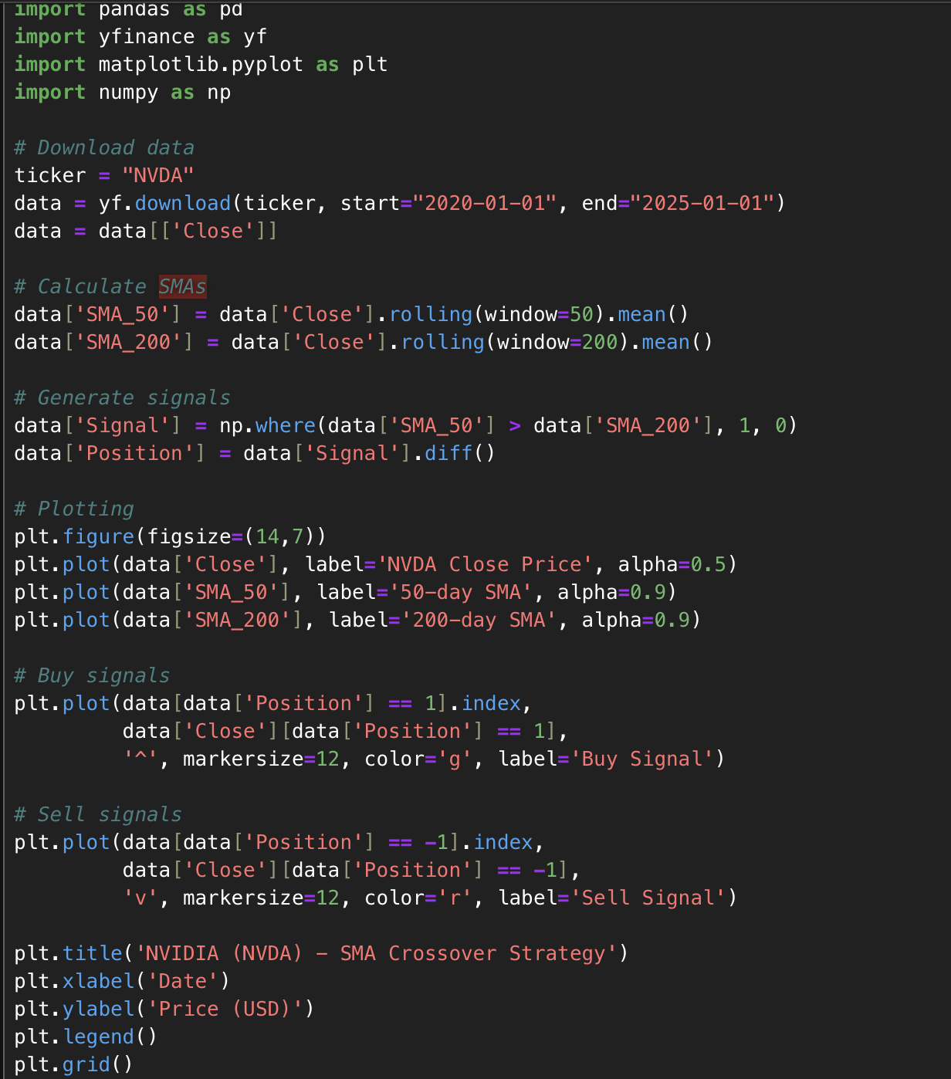
SMA Crossover Model (n=50,200)
Visualizing SMA Crossovers
We download NVDA price data from Yahoo Finance (yf.download()), focusing on the 'Close' price.
We compute 50-day and 200-day Simple Moving Averages (SMA) using .rolling().mean().
We create a new column Signal:
Set to 1 when SMA_50 > SMA_200 (bullish trend → we want to be in the market),
Otherwise, set to 0 (bearish trend → we stay out).
The Position column is the difference between current and previous signal:
1 means we just bought (0 → 1),
-1 means we just sold (1 → 0).
We then plot the signals on a price chart using green ^ for buys and red v for sells.

Slide 10
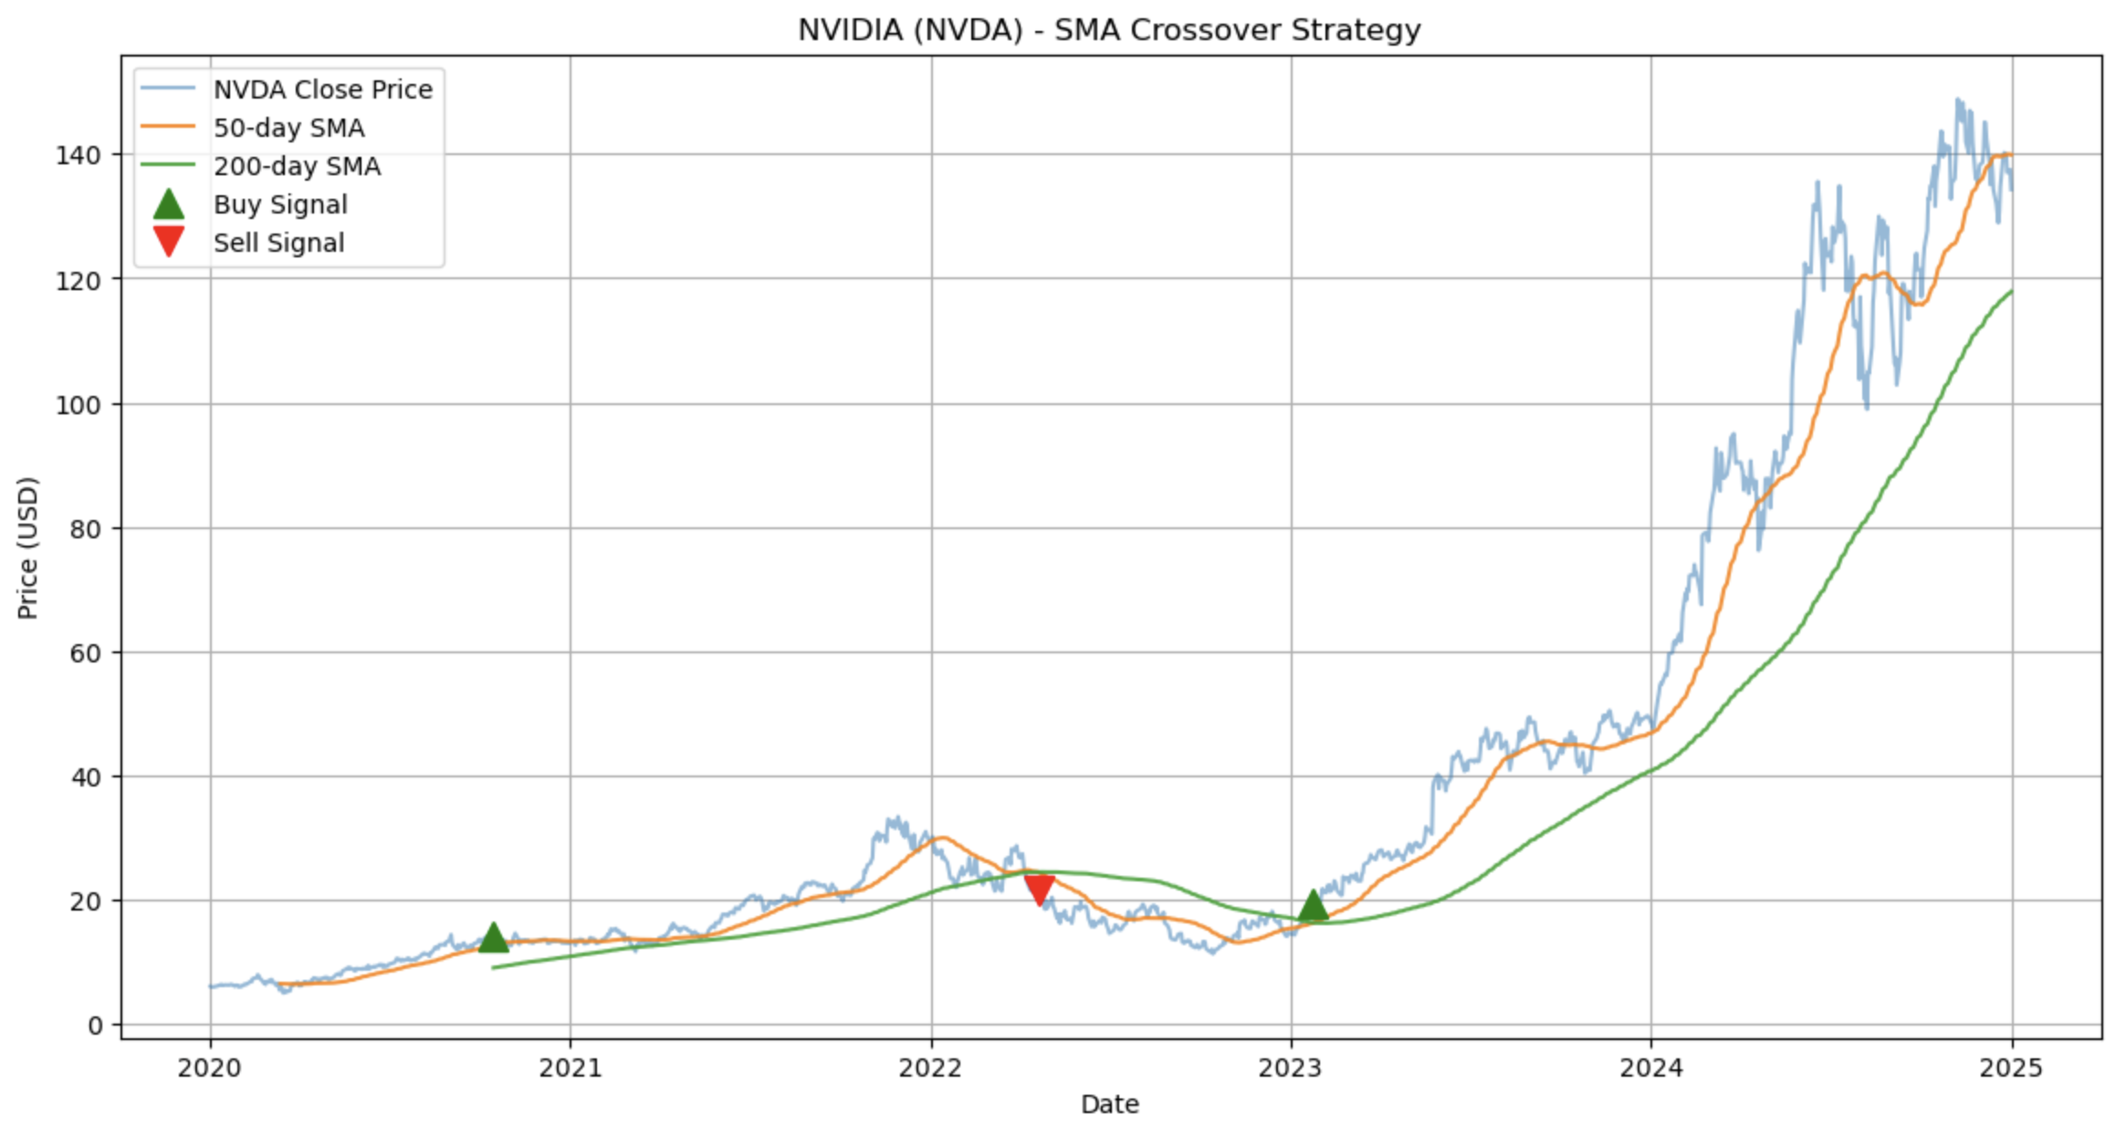
SMA Crossover Results NVDA
Visualizing SMA Crossovers
-
-

Slide 11
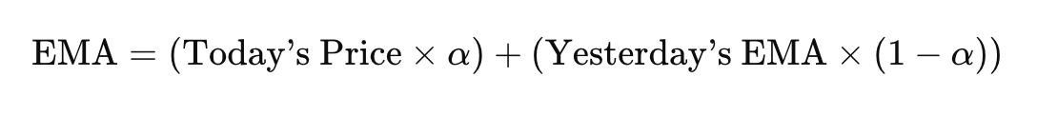
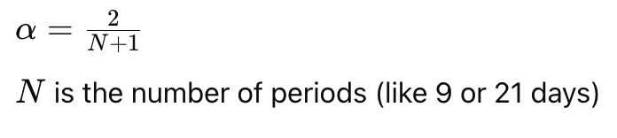
EMA – Exponential Moving Average
Visualizing SMA Crossovers
EMA – Exponential Moving Average
What is an EMA
Equation
type of moving average that gives more weight to recent prices, making it more responsive to recent changes in the market.
More responsive to price changes
Used mostly by swing traders to identify general trend directions and spot entry/exit points using crossovers.

Slide 12
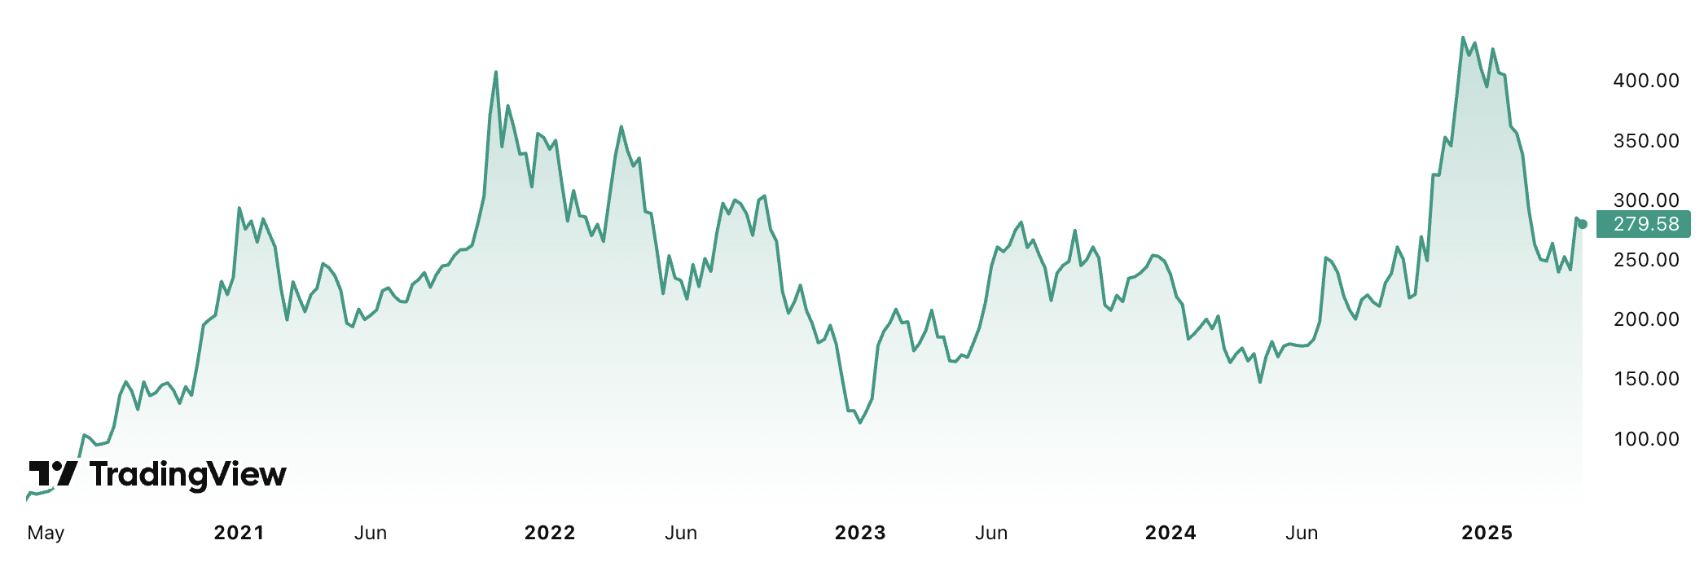
EMA Strategy
Visualizing SMA Crossovers
Strategy Overview
Space for photo of graph
Indicators: 9-day EMA (fast), 21-day EMA (slow)
Buy Signal: When 9-Day crosses above 21-Day
Inspired by the Golden/Death Cross, but using faster-reacting EMAs
Applied to Tesla (TSLA) from 2023-Current Day
Why Tesla
High Volatility
Strong Momentum trades

Slide 13
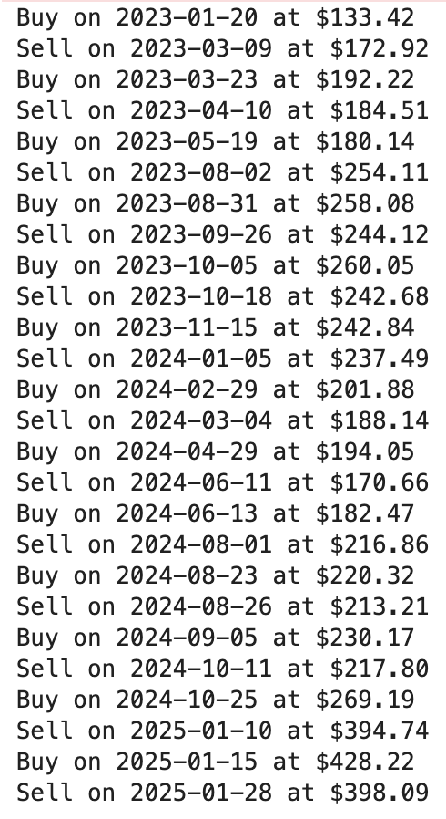
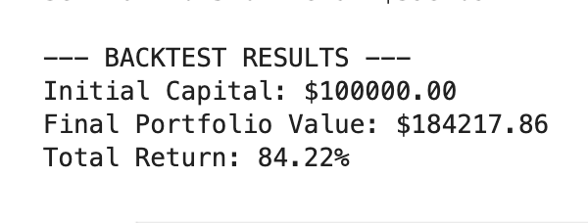
EMA – Results
Visualizing SMA Crossovers
Backtest Setup
Date Range: Jan 2023- April 2025
Rules:
Buy when 9-Day crosses above 21-day, sell when 9-Day crosses below
No partial Trades, all in or all out
Results

Slide 14
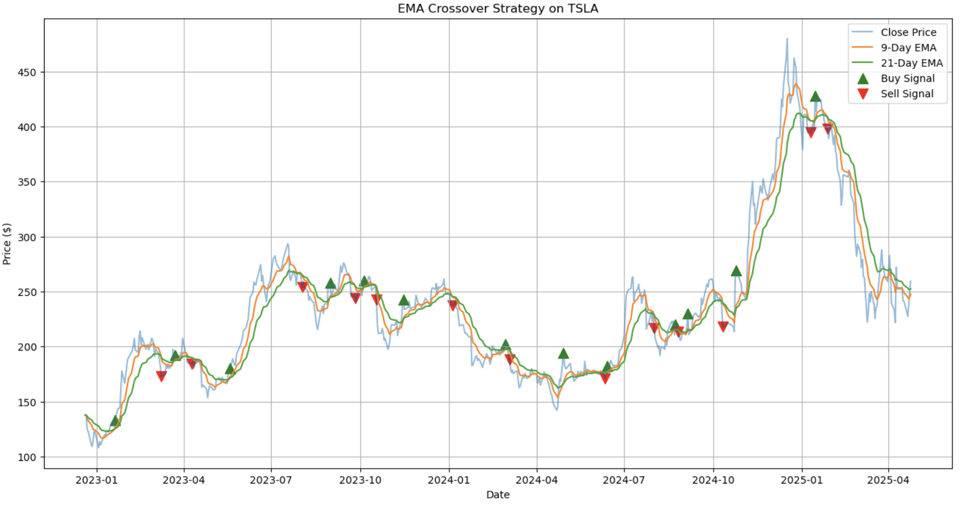
EMA – Results
Visualizing SMA Crossovers

Slide 15
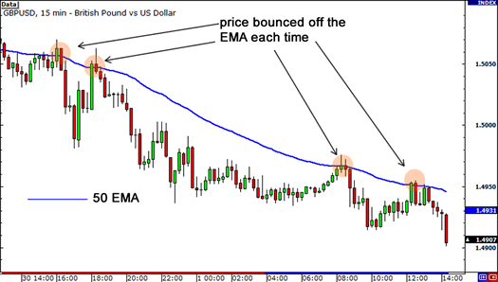
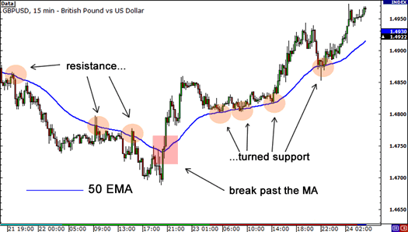
Support and Resistance
Visualizing SMA Crossovers
Resistance
Moving averages often act like dynamic support or resistance levels:
Resistance: When price is below an MA, the MA can act as a ceiling, price tends to bounce down from it.
Support: When price is above an MA, the MA can act as a floor, price may bounce up from it.
This effect is strongest with widely used MAs (e.g., 50-day, 200-day), because many traders and algorithms watch them, creating self-fulfilling behavior.

Slide 16
Limitations of SMA and EMA
Visualizing SMA Crossovers
Limitations of SMA
Limitations of EMA
Lags Behind Price
Responds slowly to recent market changes
Equal Weight to All Days
Doesn’t prioritize recent data and is less responsive in fast-moving markets
Whipsaws in Sideways Markets
Generates false signals during low volatility or choppy conditions
Not Suitable Alone for Timing
Best used to identify trends, not precise entry/exit points
Too Sensitive to Short-Term Moves
May react too quickly to price spikes, causing premature signals
Can Overemphasize Noise
Weighting recent prices more heavily may cause overreactions in volatile markets
Less Effective in Flat Markets
Still prone to giving mixed signals when there's no clear trend
Requires More Confirmation
Should be used with other tools to avoid acting on misleading crossovers

Slide 17
Conclusion: SMA vs EMA and When to Use Each
Visualizing SMA Crossovers
SMA
EMA
Equal weight to all n periods
Slower to react to price changes
Lower Sensitivity
Noise is smoother and less choppy
Greater lag
When to Use:
You're analyzing long-term trends
The market is stable or trending gradually
You want fewer false signals and smoother averages
You're focusing on support/resistance levels over time
You're trading position or swing strategies
More weight to recent data
Faster to react
Higher Sensitivity
Is more reactive, can be noisy
Less lag
When to Use:
You're tracking short-term price movements
The market is volatile or changing quickly
You need faster signals for entries/exits
You're doing day trading or scalping
You want early confirmation of trend reversals

Slide 18
References
Visualizing SMA Crossovers
https://www.alpharithms.com/moving-averages-083315/
https://blog.opofinance.com/en/50-200-day-moving-average-crossover-strategy/
https://www.simtrade.fr/blog_simtrade/moving-averages/
https://www.babypips.com/learn/forex/dynamic-support-and-resistance

